Slide 1
SIGN LANGUAGE DETECTION
USING REAL TIME DATA
GROUP - 08

Slide 2
INTRODUCTION & PROBLEM STATEMENT
Sign Language is a visual form of communication using hand gestures, body language, and facial expressions.
Examples include American Sign Language (ASL), British Sign Language (BSL), and others around the world.
Many people cannot understand sign language, which creates communication barriers for those who rely on it.
There is a need for a system that can detect and translate sign language gestures in real-time, making communication easier and more inclusive.
Goal
To develop a system that detects and recognizes hand gestures in real-time video, translating sign language into text or speech to enable better communication between signers and non-signers.
and translate sign language gestures in real-time, making communication easier and more inclusive.

Slide 3
WORKING OF SIGN LANGUAGE DETECTION SYSTEMS-PROJECT OVERVIEW.
01
02
03
04
05
06
DATA COLLECTION
PREPROCESSING
FEATURE EXTRACTION
CLASSIFICATION
REAL TIME IMPLEMENTATION
REAL TIME RECOGNITION

Slide 4
TECHNOLOGY STACK
Machine Learning (ML)
Uses TensorFlow/Keras for gesture prediction with neural networks like LSTMs
Computer Vision
OpenCV and MediaPipe for detecting and tracking hand landmarks in video.
Gesture Recognition
Interprets hand
shapes (static) and movements (dynamic gestures)
Key Tools
TensorFlow, OpenCV, MediaPipe, NumPy, and Pygame.

Slide 5
DATA COLLECTION & PREPROCESSING
DATA COLLECTION
Capture real-time video: webcam to stream video frames in real-time.
Extract landmarks: Use Media Pipe to detect and extract 21 hand landmarks (x, y, z coordinates) for each frame.
Frame segmentation: Segment video into individual frames for easier processing.
Environment setup: Collect data under diverse environmental conditions, including varying lighting, backgrounds, and camera angles.
PREPROCESSING
Normalization: Landmark coordinates are likely normalized to a consistent range.
Relative Coordinates: Coordinates may be adjusted relative to a key point to account hand position.
Sequence Creation : Frames may be grouped into temporal sequences to prepare data for models like LSTMs.
Noise Filtering: Landmark Data may be smoothed using filters to reduce jitter in detection

Slide 6
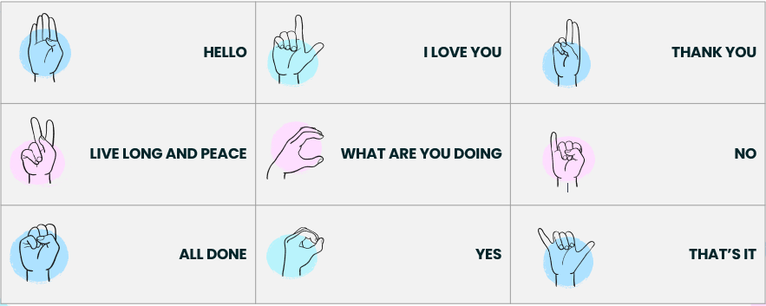
DATASET PREPARATION
Create sequences of 14 frames for temporal analysis.
Label sequences with gesture names (e.g., “Yes," “No").
Split the labeled data into training, validation, and test sets.

Slide 7
MODEL SELECTION – LSTM
Best for Sequential Data: LSTM processes temporal patterns, making it ideal for gestures that evolve over time.
Input: Preprocessed hand landmarks from Media Pipe as sequences of 10 frames.
Output: Predicts gesture classes like “Go Coogs" or “Thank you."
Media pipe extracts 21 Hand landmarks per frame providing the co-ordinates for each joint. This turns the video frames into numerical data, ideal for LSTM.
LSTM Model Processes input sequences of shape(10,126).
10 Frames
126 Features(21 Landmarks x 2 Hands x 3 Coordinates
By directly using landmarks instead of raw frames, the system skips the computational overhead of CNNs.
LSTM’s ability to capture long-term dependencies ensures accurate recognition of complex gestures.

Slide 8
WORKFLOW – REAL TIME IMPLEMENTATION
Sequence of landmarks is passed to the LSTM Model
Webcam captures video using OpenCV
Media pipe detects hand landmarks in real-time
The Model predicts gestures

Slide 9
SIGN LANGUAGE DETECTION GAME USING LSTM AND CNN

Slide 10
MODEL SELECTION FOR SIGN DETECTION GAME – LSTM AND CNN
ROLE OF CNN IN THE GAME
Identifies Key Features like landmarks from raw video frames.
Preprocesses input for temporal analysis by LSTM.
ROLE OF LSTM IN THE GAME
Understands gesture patterns over time(Eg. Forming the Number 3)
Predicts the correct gesture based on the sequence of spatial features extracted by CNN.
WHY BOTH CNN AND LSTM?
Gestures involve both spatial(hand shape) and temporal(movement over time) data.
CNN Handles spatial analysis and LSTM Processes sequential patterns ,ensuring accuracy
CNN + LSTM provides the perfect balance for real-time gesture detection, enabling an interactive and rewarding gameplay experience.

Slide 11
WORKFLOW – SIGN DETECTION GAME
MODEL TRAINING
RUN THE GAME
DATA PREPROCESSING
GAME SETUP

Slide 12
WHAT’S NEW ?
Our project stands out for combining real-time gesture recognition with an interactive game, making it both engaging and educational.

Slide 13
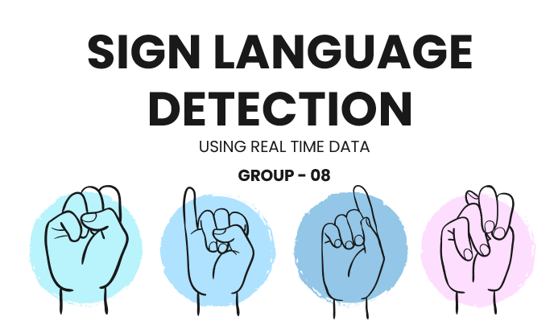
DEMO

